Slide 1
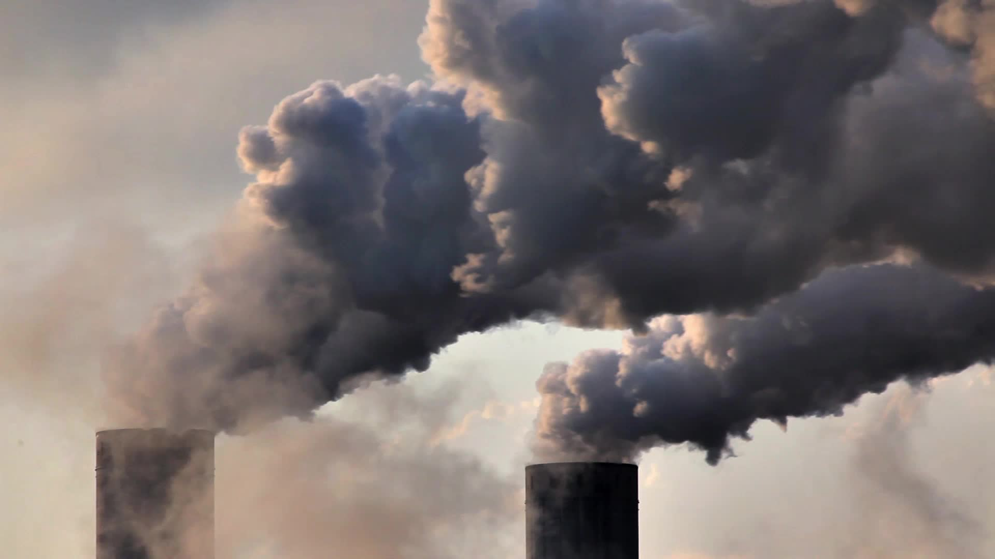
CO₂ emissions forecasting
By
Kiranmayi Vedantham

Slide 2
Introduction
Why is this problem important to solve?
Global warming is a major crisis in the world and emission of greenhouse gases is the primary factor responsible for it.
CO2 is one of the biggest contributors to this greenhouse effect.
Forecasting CO2 emissions by various energy sources can make an impact on decision-making in terms of choosing better methods of electricity production and thereby reduce emission.
Hence, solving this problem would help fight global warming
What is the intended goal?
The goal is to forecast the carbon emissions value for natural gas (NNEIEUS) fuel type for the next 12 months and propose certain measures that can be adopted as policies to reduce these emissions

Slide 3
Dataset Description:
This dataset is the past monthly data of Carbon dioxide emissions from electricity generation from the US Energy Information Administration categorized by fuel type such as Coal, Natural gas etc.
MSN:- Reference to Mnemonic Series Names (U.S. Energy Information Administration Nomenclature)
YYYYMM:- The month of the year on which these emissions were observed (from 1973 to 2016)
Value:- Amount of CO2 Emissions in Million Metric Tons of Carbon Dioxide
Description:- Different category of electricity production through which carbon is emissioned:

Slide 4
Data pre-processing steps
Conversion of "YYYYMM" column into standard datetime format & making it as index
The datatype of 'Value' column has changed from object to numeric.
Filters:
Filtering on NaT in datetime column : 5094 -> 4707
Dropping missing values in the “Value” column: 4707 -> 4323

Slide 5
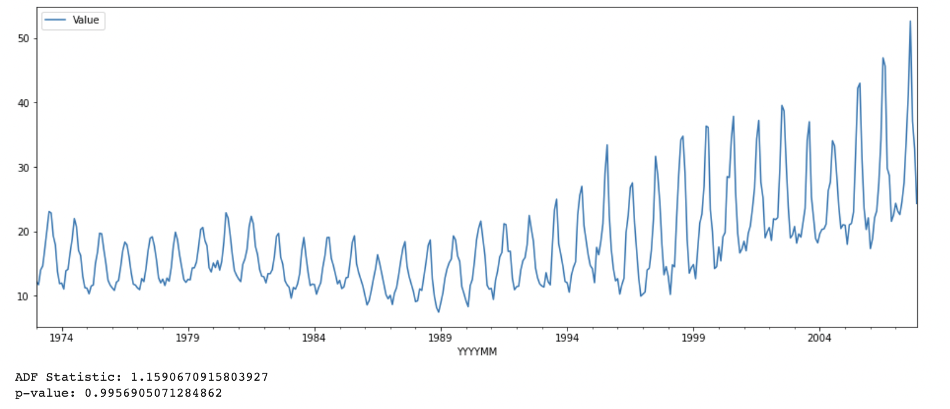
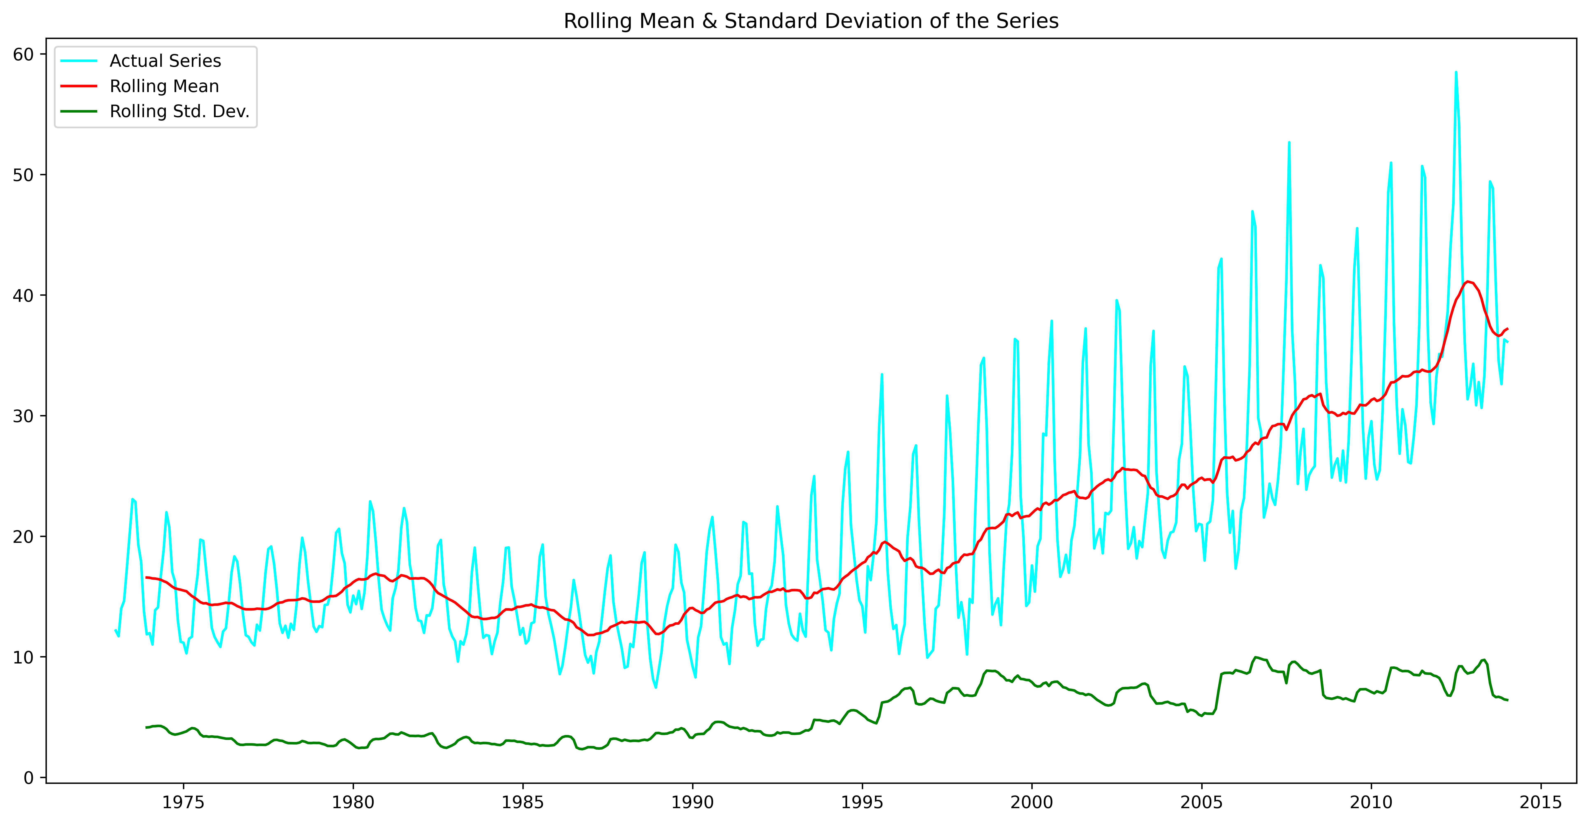
Exploratory data analysis
The data seems non-stationary
Presence of a positive trend
Follows a yearly cycle
Presence of significant heteroskedasticity
P value > 0.05 is obtained using a AD-Fuller Test
A rolling mean model captures the average trend of the data but fails to capture the seasonal variations

Slide 6
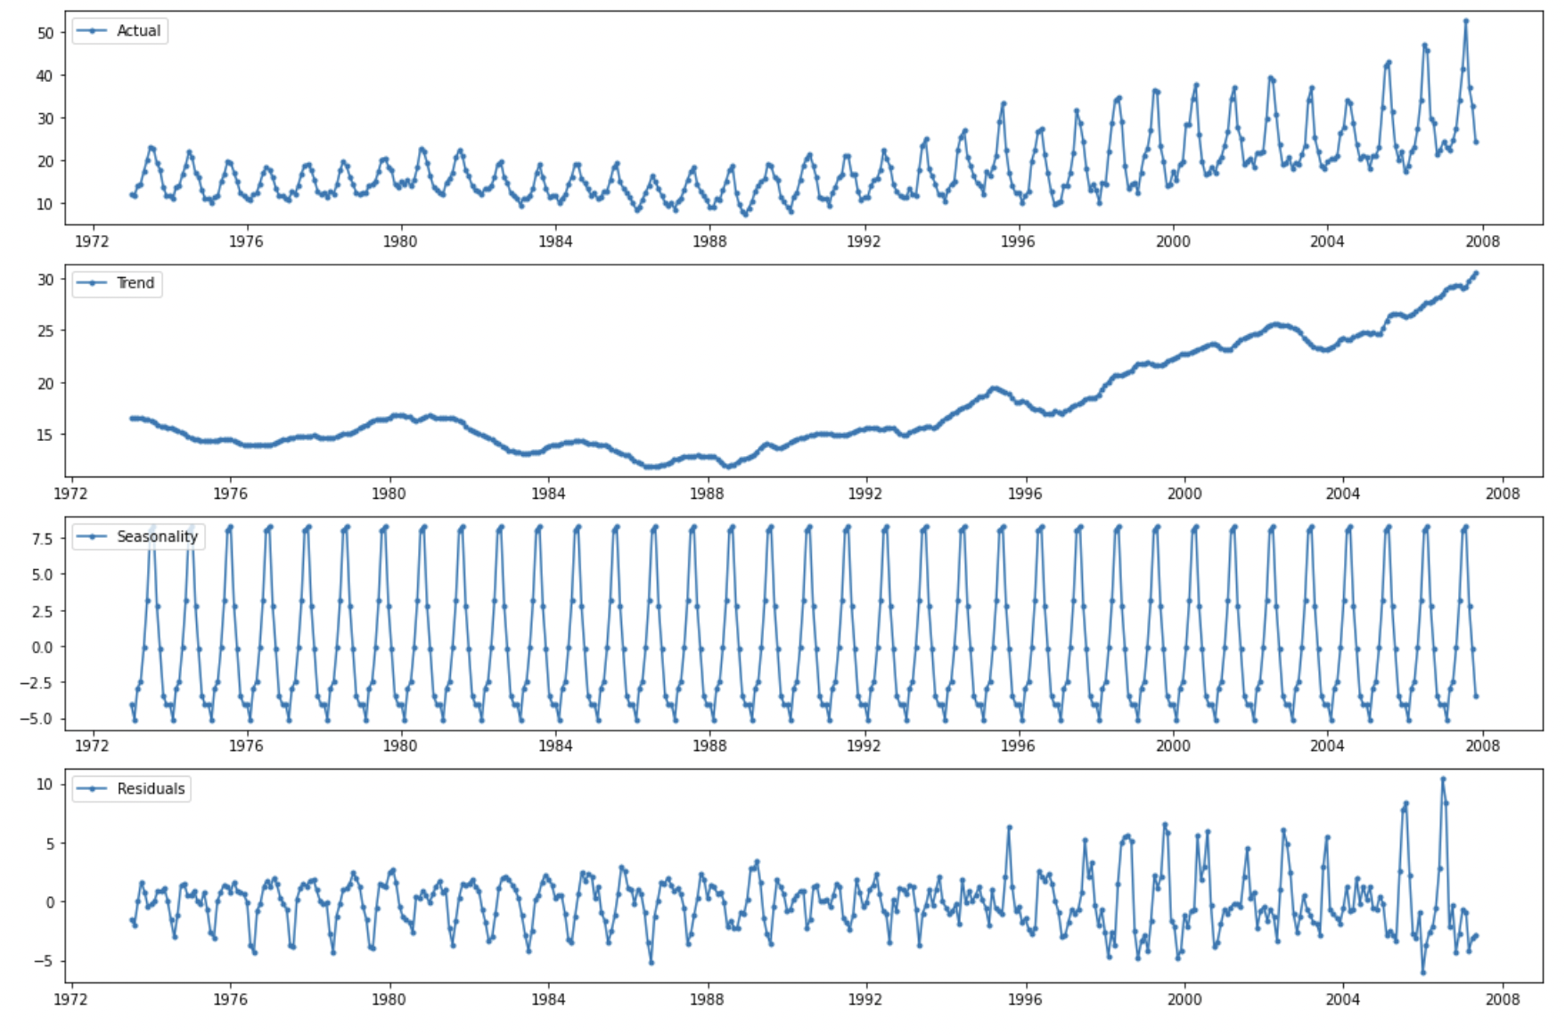
Exploratory data analysis- Trend & Seasonality
Presence of significant trend, seasonality in the series
The plot for seasonality shows that Natural gas based CO2 emissions spike in July and August.

Slide 7
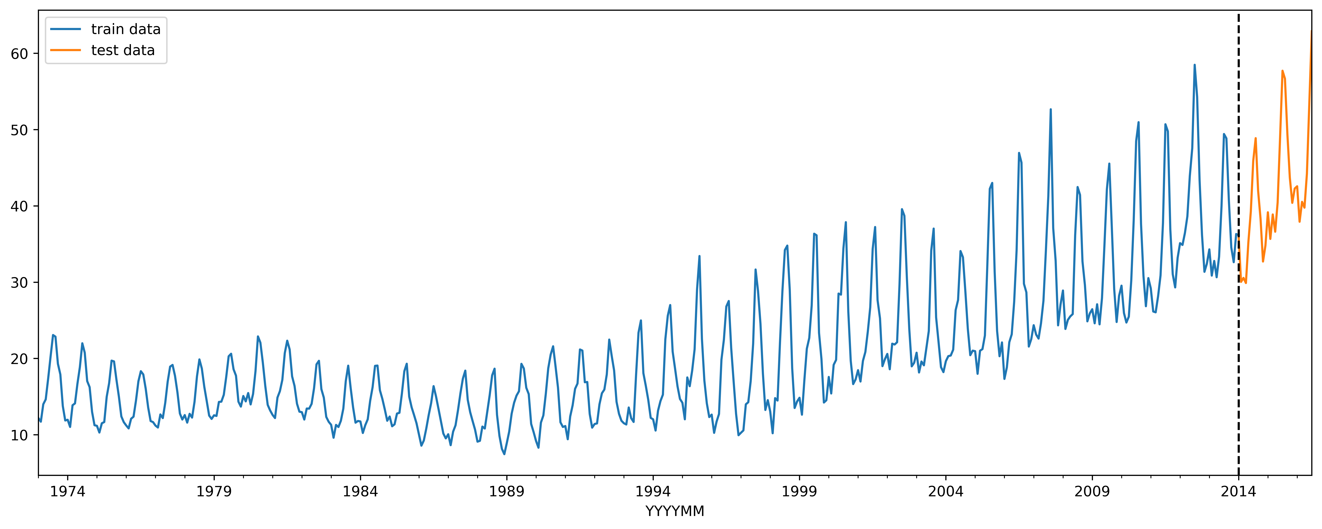
Splitting strategy
Monthly data of CO2 emissions due to natural gas from 1973 to 2016 (43 years)
Training data: first 41 years
Test data: last 2 years

Slide 8
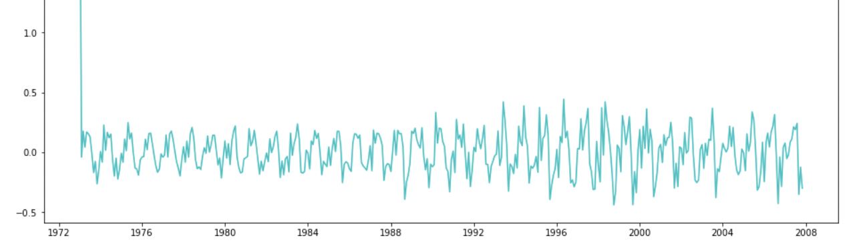
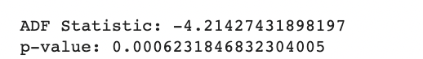
Series Transformations
Step 1 : Log transformation to reduce heteroskedasticity
Step 2 : One period differencing to remove trend
Even though stationary, some seasonal variations still observed

Slide 9
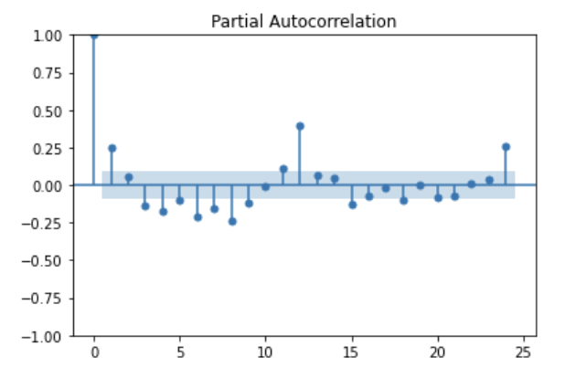
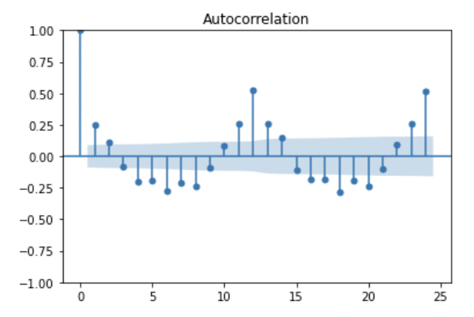
Finding optimal parameters (p,q)
PACF plot indicates This indicates that (p=1) should be sufficient to fit the data.
ACF plot indicates This indicates that (q=1) should be sufficient to fit the data.
ACF and PACF also capture the seasonality in the data
Periodicity= 12 months

Slide 10
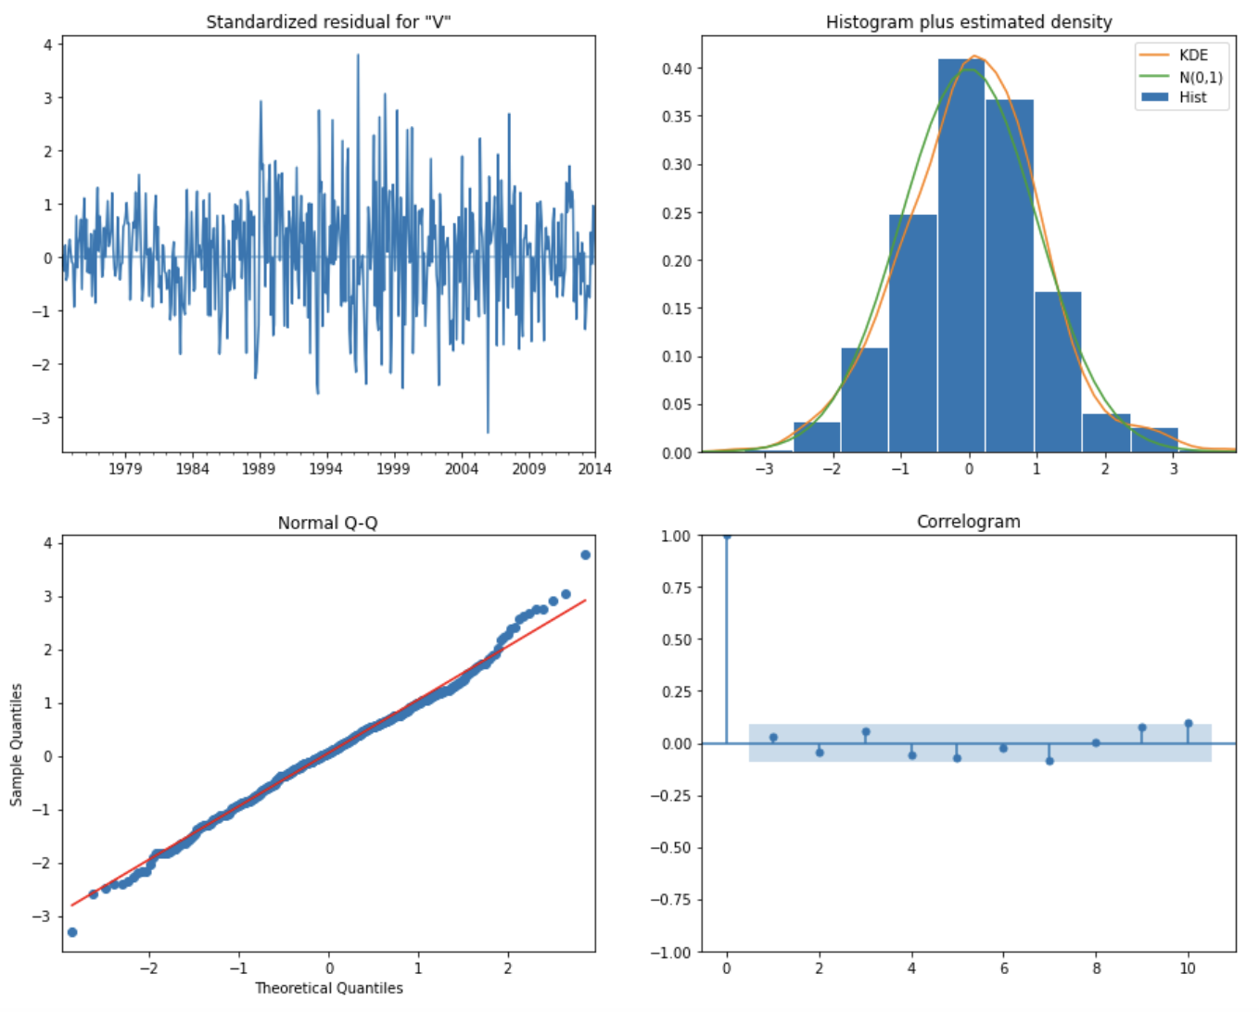
Results
Model comparisons
SARIMA Model diagnostics
 | AR | MA | ARMA | ARIMA | SARIMA
AIC | -346.16 | -157.23 | -157.23 | -370.59 | -1048.1
Selected Model:
-SARIMA model (1,1,1)x(1,0,1,12)

Slide 11
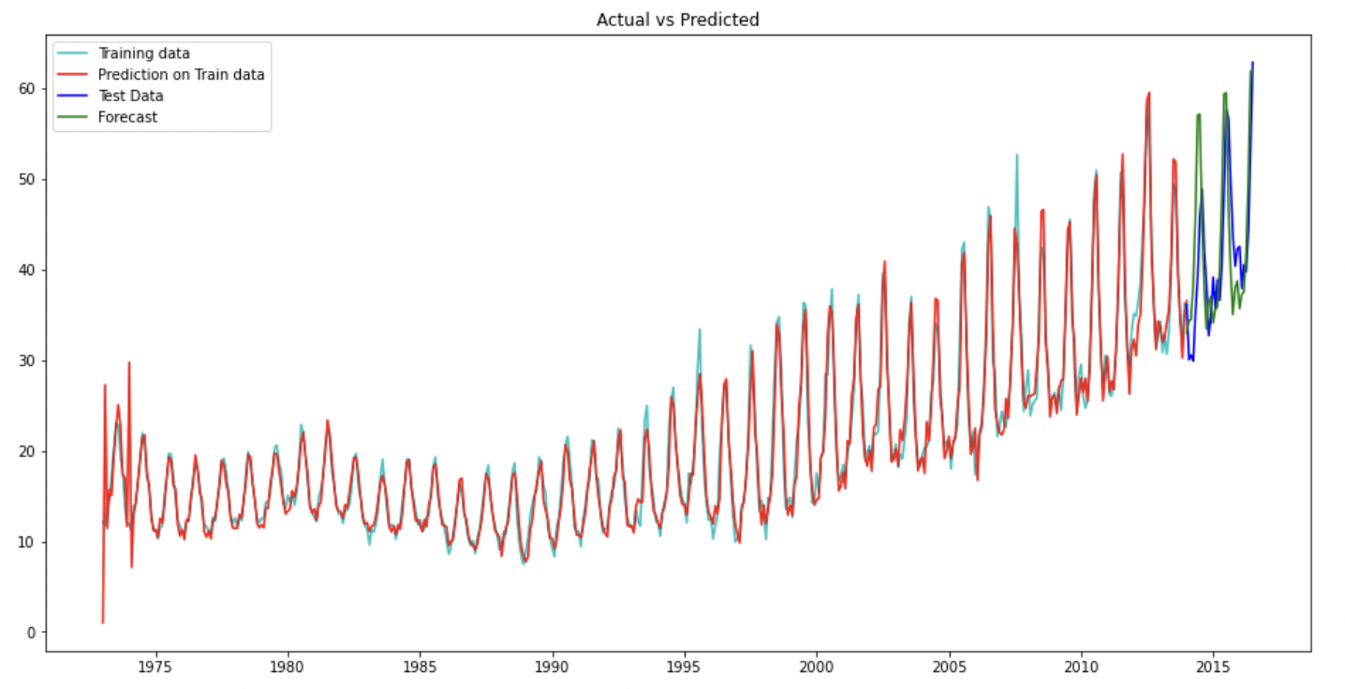
SARIMA model fit

Slide 12
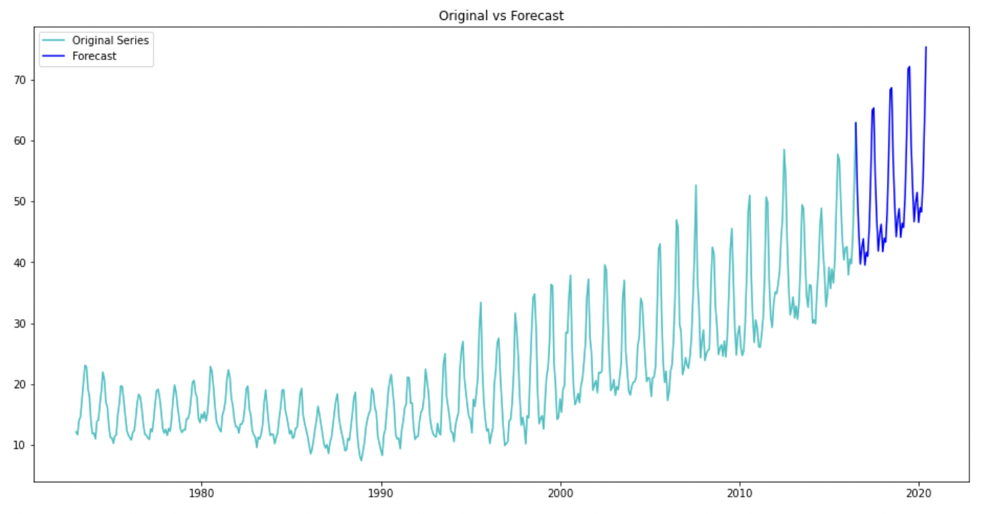
SARIMA model Forecast for 24 months

Slide 13
Conclusions
Problem: To understand how the CO2 emissions due to natural gas consumption would behave in the future.
Solution summary:
a. CO2 emissions due to natural gas consumptions in the last 40 years, display trends and seasonal patterns.
b. SARIMA model was able to capture both trend and seasonal variations.
c. SARIMA model was tuned using grid search on the training data, best model: ARIMA(1,1,1)x(1,0,1,12), AIC: -1048
d. Performance of the model was evaluated by plotting the predicted values and comparing to that of the test data
f. Forecast for the next 48 months (2016-2020) indicates upward trends and seasonal variations

Slide 14
Recommendations for Implementation
CO₂ emissions may be influenced by numerous other features in addition to past values. Hence, a supplemental analysis done by identifying key drivers and improving model forecasts
Forecasts may be used to assess environmental/health costs and used as a lever to justify increased investments in renewable energy like solar, wind etc.
A key risk in implementation is regional/geographical variation in CO2 behavior. This study may need to be done across multiple geographies to justify investment in renewable sources
A cost/benefit analysis maybe done using the forecasts. What is the cost of reducing natural gas CO2 emissions? Would the benefit gained by shifting to other sources outweigh the short-term cost of shifting sources?

